Slide 1
Reminders
Read the assigned primary research article and take notes in preparation for class on Friday (instructions and guidelines to reading primary literature on canvas)
Choose your cancer gene to research for the term project- indicate your choice on the discussion board: “Project Cancer Gene Selection” All students without a gene selection by the end of TODAY will be randomly assigned a gene to research
Review the term project instructions in the “Term Projects #1 & 2” module. Once you have a gene you can begin working on the written component of this project (due 2/4)

Slide 2
Oncogene activation
Group discussion – continued-
You are an oncologist and your patient has just been diagnosed with cancer. You know that the myc oncogene is commonly altered in this type of cancer, but before you can begin to define a therapeutic approach you need to confirm this and better understand the specific genomic lesions in this patient’s myc gene.
Use the whiteboard and describe how the following lesions may lead to activation of an oncogene (each has several possibilities)
Replication error
DNA double strand break
Whole chromosome segregation error
As a clinician or researcher, what would you look at to confirm this misregulation and/or rule out other possibilities
For each type of perturbation to the myc oncogene, what would the DNA look like? The RNA? The protein?

Slide 3
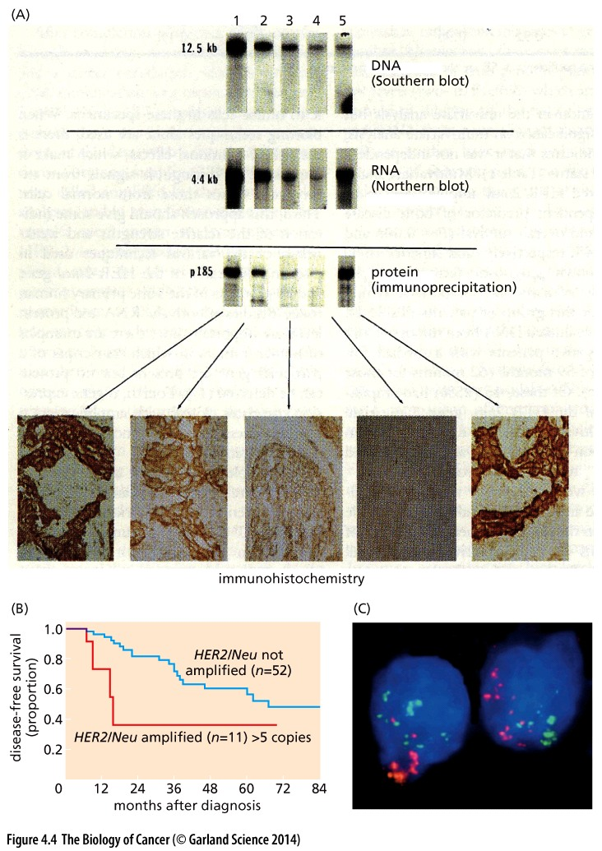
Increases in the HER2 oncogene promote breast cancer
How are increased oncogene levels achieved?
This figure shows HER2 protein is increased in tumors 1, 2, 3 and 5
DNA is increased in only tumor 1
What type of chromosomal change could account for increased HER2 in tumor 1?
Is there a different explanation for how protein levels of HER2 might become elevated in tumors 2, 3 & 5?
Mini discussion

Slide 4
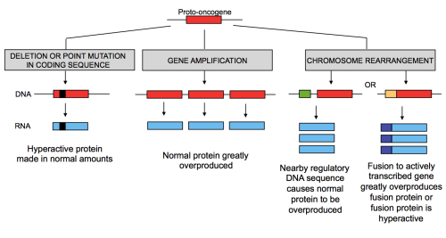
Varied ways to activate an oncogene
proto oncogenes can be activated by changes in gene number or expression…
Tumor 4 is also driven by HER2. How can this be?

Slide 5
Varied ways to activate an oncogene
proto oncogenes can be activated by changes in gene number or expression…
…or gene function
What tools do we have to analyze many genes or many patients at one?

Slide 6
Lecture 4: Cellular Oncogenes
OBJECTIVES
Be able to provide examples of intrinsic and extrinsic sources of mutations
Be able to provide examples of the similarities and differences between viral oncogenes and cellular oncogenes
Be able to explain an experimental approach testing the transformative potential of an agent or gene

Slide 7
What causes mutations in DNA?

Slide 8
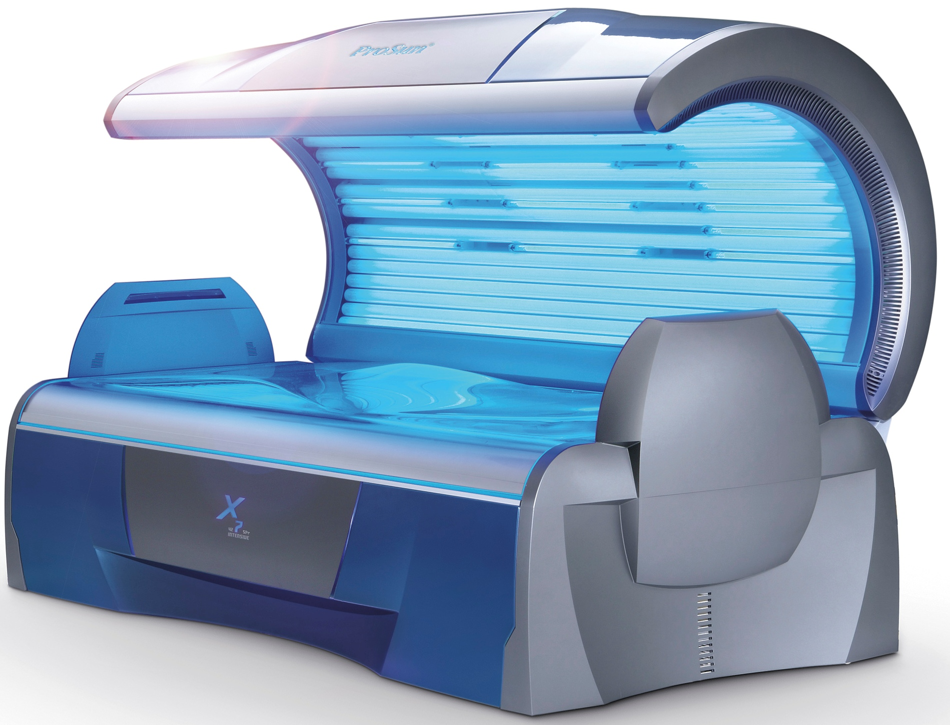

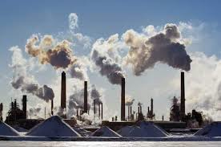
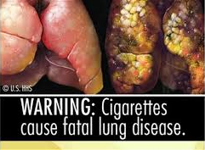
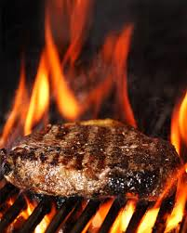
DNA damage can cause mutations
What causes DNA damage?
DNA damage and mutations are also caused by normal endogenous factors
Reactive oxygen species (ROS) produced by normal metabolic products
Errors in DNA replication (~1 error for every 100 million bases)
UV light from the sun
smoking
UV light in tanning beds
pollution
Charred meat

Slide 9
Over 300 billion bases of DNA in each cell
300 billion /100 million=
each cell can experience ~1 million replication errors per cell cycle…
3,000,000,000,000,000,000
Total DNA lesions in our bodies every day
DNA repair pathways catch nearly all of these, but some go uncorrected and mutations naturally accumulate overtime
How many mutations occur with each cell division in normal cells?
What would happen if a replication proofreading gene were mutated?
~3
Lodish, H; Molecular Biology of the Cell, 5th Edition

Slide 10
Mutations naturally occur with time
Tomasetti et al., Science, 2017
Estimated that ~66% of all driver mutations arise from normal mutation rates
Is cancer an inevitable consequence of ‘bad luck’?

Slide 11
Mutations naturally occur with time
Tomasetti et al., Science, 2017
Estimated that ~66% of all driver mutations arise from normal mutation rates
29% arise from environmental factors
5% are hereditary

Slide 12

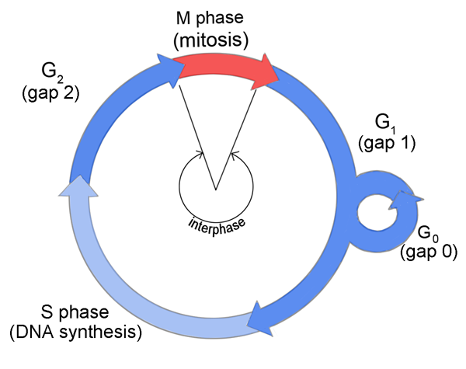
How might ‘bad luck’ play a role?
Most mutations don’t impact cancer genes
Up to 11 mutations are required in the same cell to generate cancer
Intact checkpoints can weed out mutated cells that are ‘less fit’
Mutation in a checkpoint gene could permit mutated cells to continue onto a next cell cycle
→ More proliferation = more mutations
Cell size?
Replication complete?
DNA damage?
Spindle assembly?
Chromosome attachment?
Cell size?
Nutrients available?
Growth Factors present?
DNA damage?

Slide 13
Can cancer be inherited?
What does it mean to have an inherited mutation?
Do all people with an inherited mutation get cancer?
Does it make a difference if the mutated gene is a tumor suppressor or an oncogene
If a person has an inherited mutation in a cancer gene does that mean that their mom or dad had cancer?
Tomasetti et al., Science, 2017
Estimated that ~66% of all driver mutations arise from normal mutations rates
29% arise from environmental factors
5% are hereditary

Slide 14

Can cancer be inherited?
Mutations can occur in BOTH somatic cells and germ cells
Mutations can be inherited- cancer can not
Humans have >100 different DNA repair genes
Function as tumor suppressors
Inherited mutations in these lead to cancer predisposition
BRCA1 and BRCA2 are important to repair DNA double strand breaks
mutations can be inherited and are known to predispose women to breast and ovarian cancers: ~60% risk of breast cancer

Slide 15
Oncoviruses
Tomasetti et al., Science, 2017
Estimated that ~66% of all driver mutations arise from normal mutations rates
29% arise from environmental factors
5% are hereditary
Exposure to chemicals
UV light
Some types of viral infections

Slide 16
Oncoviruses in cancer
Initially thought to be THE cause of cancer
→ we now know viruses contribute to only a subset of cancers
Involvement of viruses (and other infectious agents) in cancer continue to be a challenge worldwide
→ Prevent and treat infection to limit cancer

Slide 17
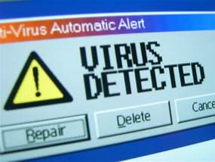
Viral contributions to cancer
Viruses are infectious agents that can only replicate within cells of other living organisms
Human are affected by a variety of viruses
Common cold
Influenza
AIDS
Cancer
Viral infection is responsible for 15-20% of cancers

Slide 18
Viral impact on the human genome
In some ways viral contributions to cancer are similar to random mutagenesis
There are 3 main ways that viruses contribute to cancer:
Disrupt normal gene sequence with insertions (similar to mutagenesis)
Hijack a gene and promote its function (similar effect as oncogene translocations/fusions)
Express an inhibitor of gene function (a viral oncogene)

Slide 19
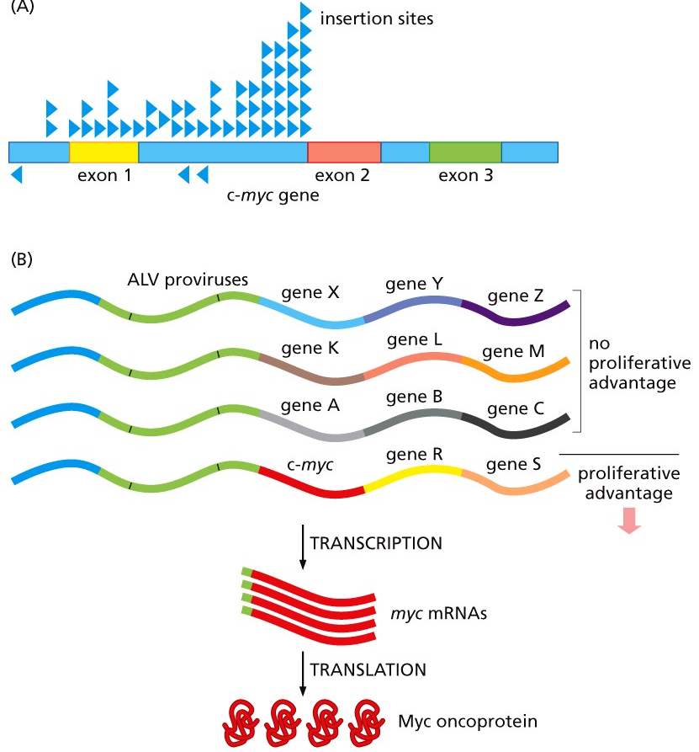
Viruses integrate into the genome
Integration: virus integrates into the host cell’s genome and causes activation or inactivation of oncogenes or tumor suppressors
Integration is random (similar to random mutagenesis)

Slide 20
Viruses integrate into the genome
Integration: virus integrates into the host cell’s genome and causes activation or inactivation of oncogenes or tumor suppressors
Integration is random (similar to random mutagenesis)
position of the integration can disrupt nearby genes
changes in the regulation of a proto-oncogene or tumor suppressor can be tumorigenic

Slide 21
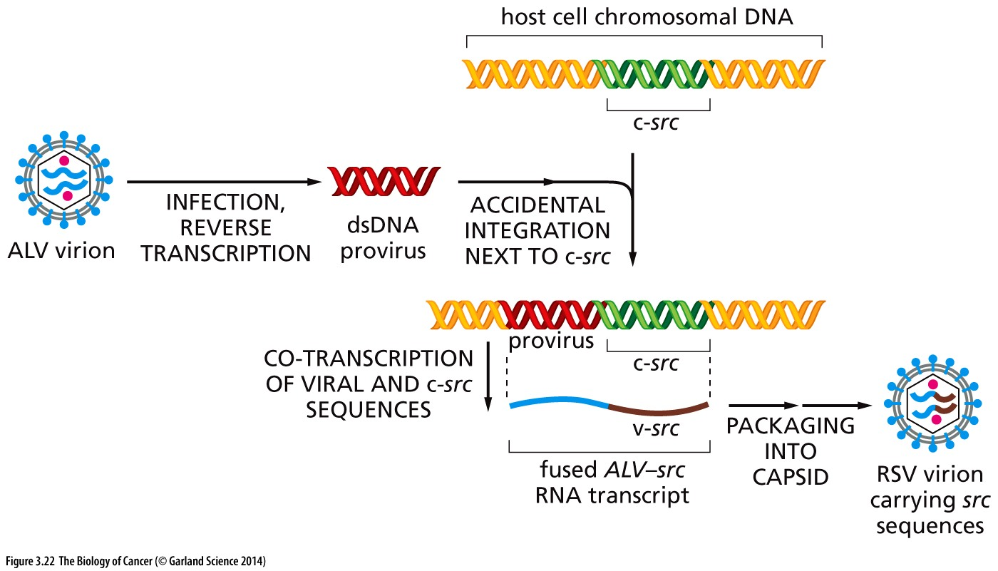
Viruses amplify oncogenes
Increase oncogene copy number: ancient RNA virus integrated into the host cell’s genome and ‘captured’ a host proto-oncogene
Captured gene becomes part of the viral genome
Viral infection leads to high expression of the oncogene and more rapid tumorigenesis

Slide 22
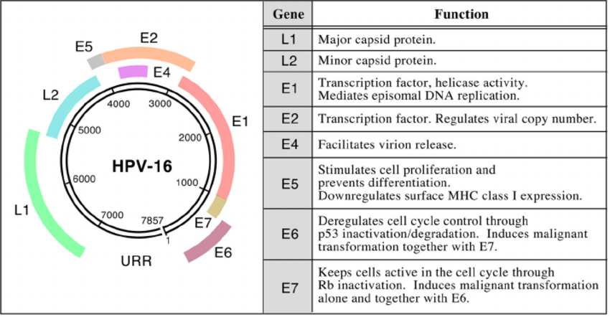
Viral proteins interfere with checkpoints
Expression of viral oncogenes that corrupt cellular pathways
Bind to and interfere with tumor suppressor function (p53, pRB: regulators of G1/S transition)
Responsible for ~80% of viral-induced cancers
HPV
HVC/HVC

Slide 23
Tumorigenesis is linked to viral integration
Viral genome is initially episomal
Hitches a rid on chromosomes with a linker protein
Viral particles are made, packaged and released to infect adjacent cells
Persistent infection: allows for transmission without re-infection
Still low risk for cell transformation
Human DNA Viral DNA

Slide 24
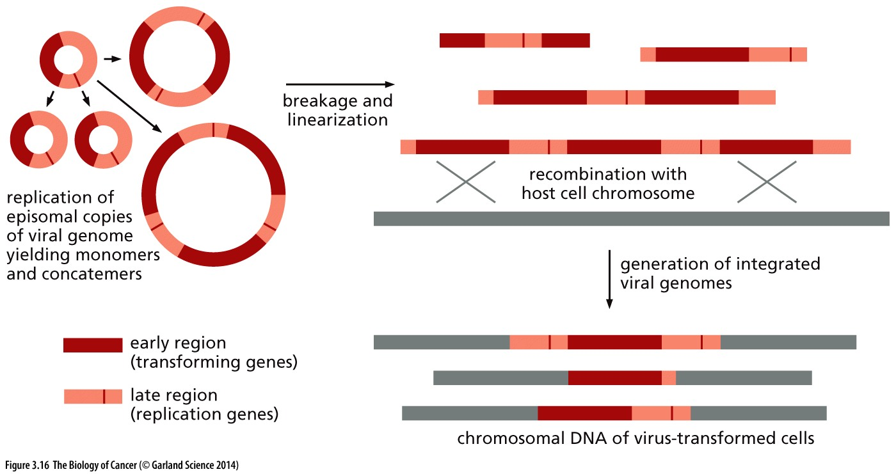
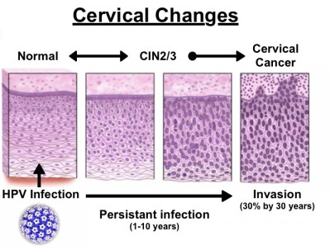
Tumorigenesis is linked to viral integration
Integration via HR
integrated viral DNA gets replicated and segregated with the host genome
Frees viral oncogene from transcriptional repression
Allows high expression on viral oncogenes
Cellular transformation is enabled
Integration is required for tumorigenesis
What therapeutic approaches does this suggest might be appropriate?

Slide 25
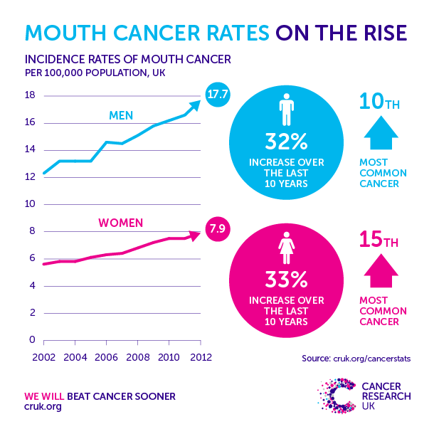
Vaccines as a cancer preventative
Vaccines that reduce long-term HPV infection have the potential to prevent cervical cancer (and other cancers!)
HPV is also responsible for ~20% of oropharyngeal cancers
Cancer genes are conserved in all cell types
Cancers of the mouth and throat continue to rise, even as tobacco-induced tumorigenesis in these tissues decline

Slide 26
Identifying cancer-promoting agents
How can we identify genes (or infectious agents, or chemicals) that promote cellular transformation?

Slide 27
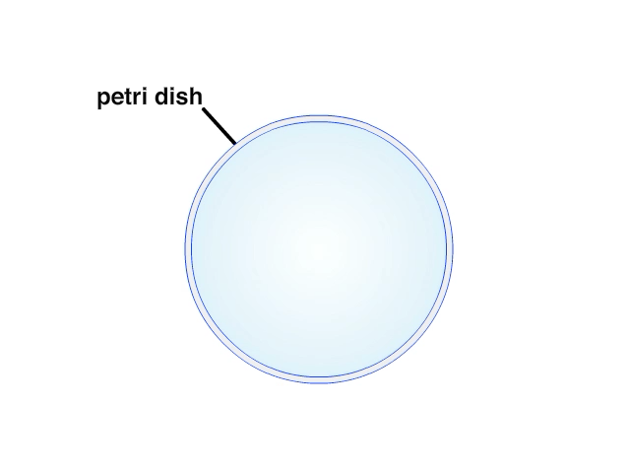
Growth changes in transformed cells
Remain proliferative when normal cells do not
When nutrients are lacking
When external growth signaling is lacking
When cells are confluent
Overgrowth becomes apparent in culture conditions
Can grow independent of adherence

Slide 28
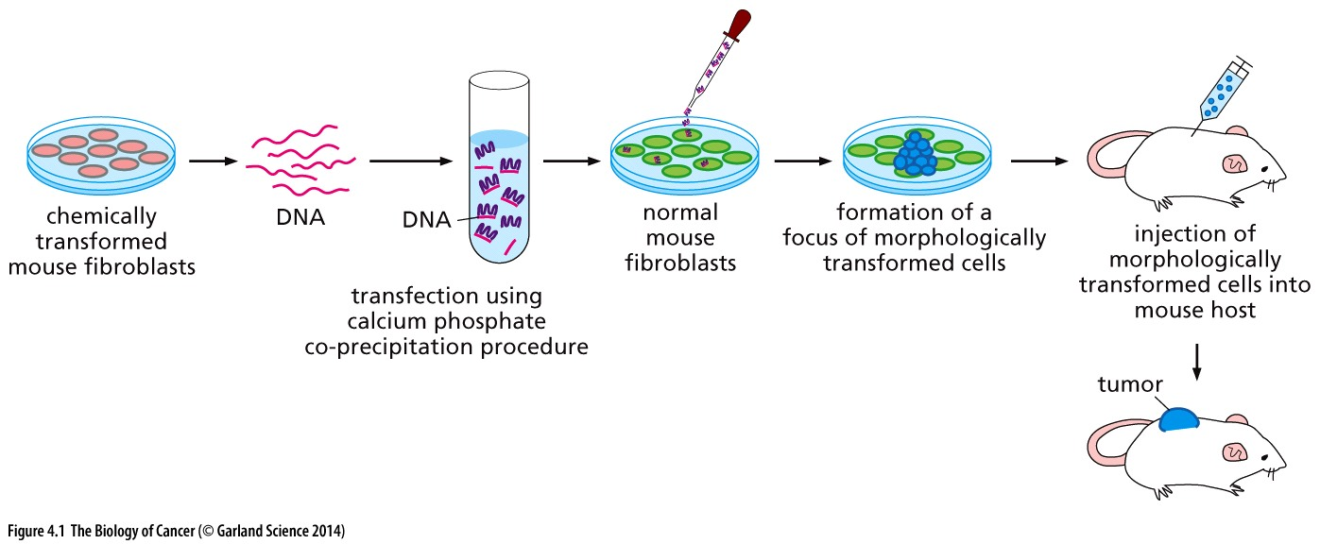
Identifying endogenous cancer genes
If nonviral oncogenes exist, DNA from a transformed cell should be able to promote transformation in a normal cell
Think/Pair/Share: is this transforming ability unique to oncogenes? Or will mutant tumor suppressors similarly be able to transform normal cells? Why or why not?
DNA from non-transformed cells did not induce transformation when transfected into normal fibroblasts

